Slide 1
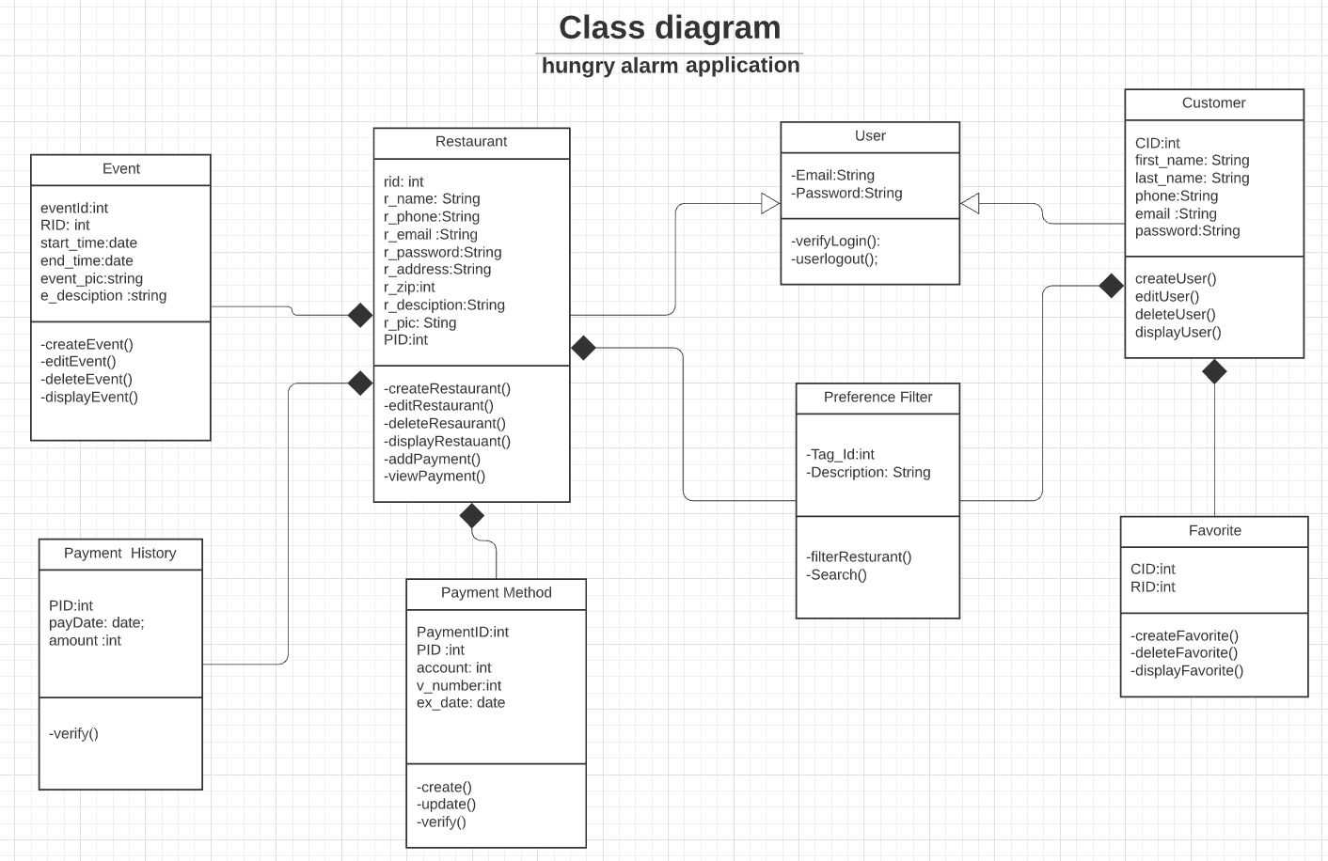
creates
creates
creates
has
creates or updates restaurant types
searches
restaurants
adds
has
Notes:
https://www.lucidchart.com/documents/edit/d4e8dc9f-7c1f-4cac-8d7d-f846e8784c20?shared=true&

